Slide 1
Analyzing Demographic and Regional Disparities in Tele-Law Case Registrations for Inclusive Legal Access
CAPSTONE PROJECT
Presented By:
1. Utkarsh Kishor – IILM University – Computer Science and Engineering

Slide 2
OUTLINE
Problem Statement
Proposed System/Solution
System Development Approach
Algorithm & Deployment
Result
Conclusion
Future Scope
References

Slide 3
Problem Statement No. 37
Despite the nationwide expansion of Tele-Law, significant concerns exist about its equity and effectiveness. The program lacks a data-driven understanding of its user base, leading to potential gaps in service for marginalized communities. The challenge is to analyze demographic and regional data from case registrations to uncover utilization disparities among different genders, caste groups (SC, ST, OBC), and districts, while accounting for the varying number of Common Service Centers (CSCs) per region.

Slide 4
Proposed Solution
Gather anonymized case registration data from all Common Service Centers (CSCs), including details on gender, caste category (SC, ST, OBC, General), and date of consultation.
The proposed solution aims to address the challenge of identifying and mitigating disparities in the Tele-Law program. By leveraging data analytics, the system will provide a comprehensive understanding of service utilization across different demographic and geographic segments, enabling data-driven policy-making to improve equitable access to legal aid. The solution will consist of the following components:
Data Collection and Integration:
Gather anonymized case registration data from all Common Service Centers (CSCs), including details on gender, caste category (SC, ST, OBC, General), and date of consultation.
Collect geographic data for each case, specifying the district and state.
Compile a master list of all active CSCs and their locations to map service availability against population density.
Data Preprocessing and Cleaning:
Clean and standardize the collected data to handle inconsistencies, missing demographic information, and formatting errors.
Ensure all personally identifiable information (PII) is removed to maintain user privacy and confidentiality.
Merge case data with CSC location data to create a unified dataset for analysis.

Slide 5
Proposed Solution
Gather anonymized case registration data from all Common Service Centers (CSCs), including details on gender, caste category (SC, ST, OBC, General), and date of consultation.
Analysis and Disparity Modeling:
Conduct an exploratory data analysis (EDA) to calculate and visualize utilization rates broken down by gender, caste, and district.
Develop a normalization model to account for the varying number of CSCs in different regions. This could involve creating metrics like 'registrations per CSC' or 'registrations per 100,000 people' in a district.
Apply statistical tests (e.g., chi-squared test) to determine if the observed differences in utilization among demographic groups are statistically significant.
Deployment (Insight Dashboard):
Develop an interactive, user-friendly dashboard for policymakers and program administrators.
The dashboard will feature heatmaps to visualize geographic "hotspots" and "coldspots" of service utilization across the country.
Include dynamic charts and graphs that allow users to filter data by state, district, time period, and demographic group to explore intersectional disparities.

Slide 6
System Approach
The 'System Approach' section outlines the overall strategy, technical requirements, and tools needed to develop and implement the Tele-Law disparity analysis system.
System Requirements
Functional Requirements:
Data Ingestion: The system must be able to securely import and integrate anonymized case data from multiple sources (e.g., CSV files, databases).
Data Processing: It must include modules for cleaning, standardizing (e.g., caste categories, district names), and preparing the data for analysis.
Analytical Engine: The system must be capable of calculating key performance indicators such as utilization rates, demographic breakdowns, and normalized metrics (e.g., cases per CSC).
Interactive Dashboard: A web-based interface that allows users to filter data by state, district, gender, caste, and date range to explore trends.
Geospatial Visualization: The system must generate interactive maps (heatmaps) to display regional disparities in service access.
Reporting: Ability to export visualizations and summary data into reports for stakeholders.

Slide 7
System Approach
Non-Functional Requirements:
Security: The system must ensure the privacy and confidentiality of the anonymized data through access controls and secure data handling practices.
Scalability: The architecture must be able to handle an increasing volume of case data as the Tele-Law program expands.
Performance: The dashboard must load quickly and respond to user queries and filters with minimal latency.
Usability: The interface should be intuitive and easily navigable for non-technical users like government officials and policymakers.
Libraries and Tools for Analysis and Visualization
Watsonx.ai Studio Service

Slide 8
Algorithm & Deployment
Algorithm
This section describes the analytical methodology chosen for identifying and quantifying disparities in Tele-Law service utilization. As the goal is analysis rather than prediction, the approach focuses on statistical methods.
Algorithm Selection
A Statistical Disparity Analysis approach is used. This method is chosen because the problem requires measuring and validating existing patterns in historical data, not forecasting future trends. The core of this approach involves descriptive statistics, normalization to ensure fair comparisons, and significance testing to validate the findings.
Data Input
The analysis utilizes three primary data sources:
Case Registration Data: Anonymized records containing gender, caste category (SC, ST, OBC, General), and district for each legal aid consultation.
CSC Infrastructure Data: A list of all active Common Service Centers (CSCs) and their corresponding districts.
Regional Population Data: Official census data on the demographic makeup (caste/gender) of each district to provide a baseline for comparison.

Slide 9
Algorithm & Deployment
Analysis Process
The analysis is performed in stages. First, the raw data is aggregated to count the number of cases per demographic group within each district. Second, a normalized utilization metric (e.g., 'Cases per 10,000 people' or 'Cases per CSC') is calculated for each district to allow for fair comparisons between regions of different sizes. Finally, a Chi-Squared test is applied to determine if the observed distribution of service users deviates significantly from the district's known demographic distribution.
Output and Insight Generation
The process does not predict future values but generates concrete insights. The output is a structured dataset that includes:
The calculated disparity score and normalized metrics for each district.
The p-value from the statistical test, indicating the confidence level in the observed disparity.
A ranked list identifying the most underserved districts and demographic groups.

Slide 10
Algorithm & Deployment
Deployment
This section outlines the plan for making the analytical insights accessible to program administrators and policymakers through an interactive platform.
Platform and Technology
Hosting and Scalability
User Interface and Features
Access and Security

Slide 11
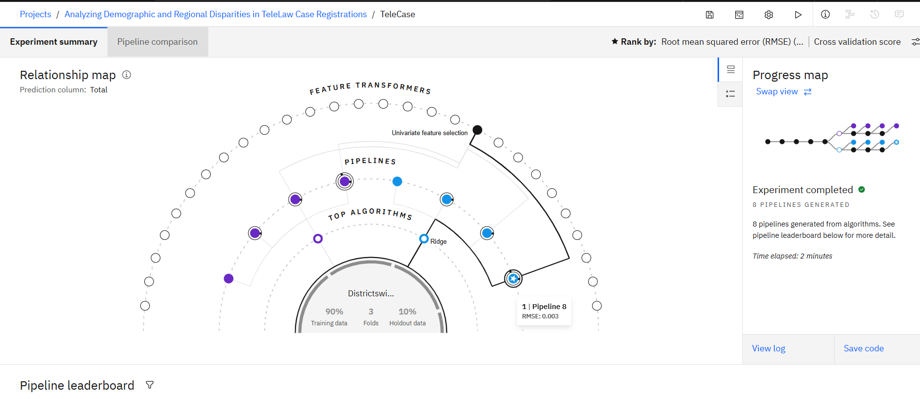
Result

Slide 12
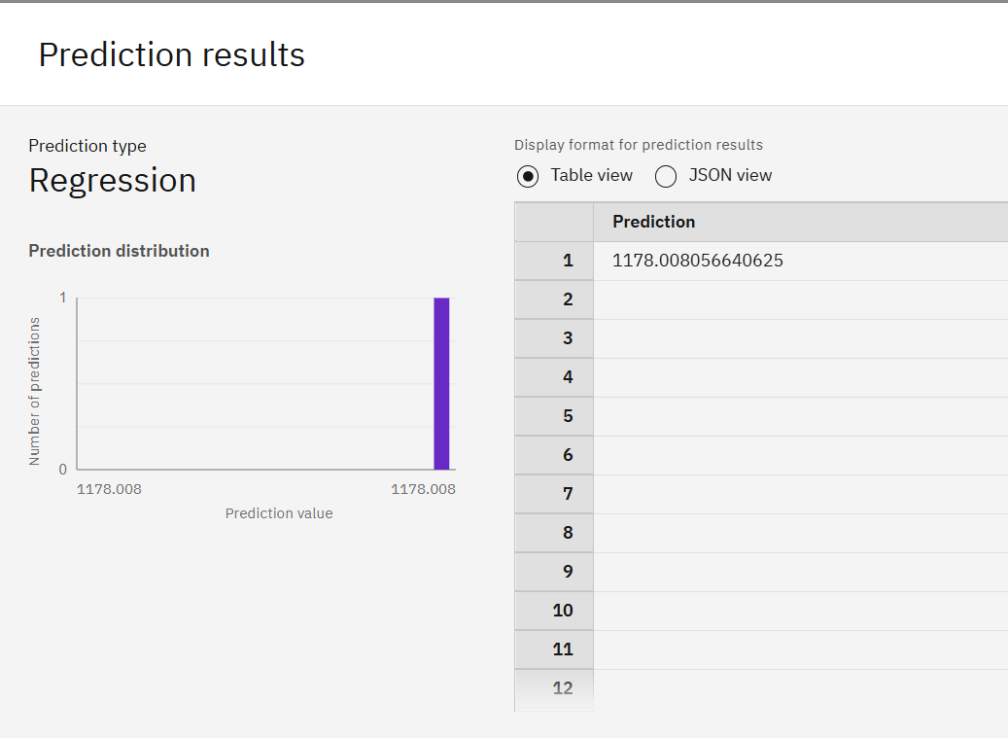
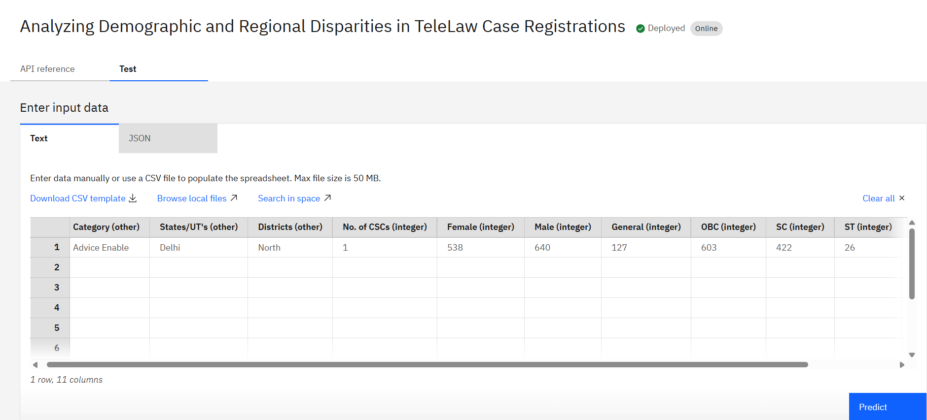
Result

Slide 13
Conclusion
This project presents a data-driven framework to systematically evaluate and enhance the inclusivity of the national Tele-Law initiative. By moving beyond raw registration numbers and employing a robust analytical approach, the proposed system directly addresses the critical challenge of ensuring equitable access to justice for all citizens. The solution provides a clear, evidence-based methodology to identify, measure, and visualize significant disparities in service utilization based on gender, caste, and geography, while critically accounting for regional differences in service infrastructure.
Looking forward, this system establishes a foundation for future enhancements, including the integration of predictive analytics to forecast legal aid demand and the inclusion of qualitative feedback to understand the root causes of service gaps. Ultimately, this project serves as a vital tool in fulfilling the core mission of Tele-Law: to bridge the gap between citizens and justice, one empowered individual at a time.

Slide 14
Future scope
The successful implementation of this analytical dashboard will create a foundation for several powerful future enhancements. The following expansions can further augment the system's capabilities and deepen its impact on delivering equitable justice:
Predictive Analytics for Proactive Interventions
Deeper Insights through Data Enrichment
Technological and Platform Enhancements

Slide 15
References
This section provides a list of representative data sources, academic literature, and technical documentation that inform the proposed methodology and approach.
Department of Justice, Ministry of Law & Justice, Government of India. (2024). Tele-Law 2.0: Scheme Guidelines and Framework. Retrieved from the official Department of Justice website.
National Informatics Centre (NIC). (2023). Technical Documentation for CSC Data Integration API. Government of India.
Ministry of Electronics and Information Technology. (2023). Digital India Programme: Annual Performance Report. Government of India.

Slide 16

IBM Certifications

Slide 17

IBM Certifications

Slide 18

IBM Certifications

Slide 19
THANK YOU

